Slide 1
Journey Presentation
Name: Manav Ananthakumar
Shell IDA Batch 4

Slide 2
Day 1: Ganesh Chaturthi Holiday
HOLIDAY

Slide 3
Day 2: Python
Data Structures
DataFrame: Tabular data structure in pandas, similar to a spreadsheet or SQL table.
Series: A one-dimensional labeled array capable of holding data of various types.
Lists: Basic Python data structure for holding ordered elements.
NumPy Array: Fundamental package for numerical computing in Python.
Data Handling Tools
Dictionaries: Key-value pairs to store and retrieve data efficiently.
Sets: Unordered collection of unique elements.
Tuples: Immutable, ordered collection of elements.
Data Science Libraries
Map: Built-in Python function for applying a function to all items in an input list.
Pandas: Data manipulation and analysis library for structured data.
Matplotlib: Python plotting library for creating static, animated, or interactive visualizations.
SciPy: Library for scientific and technical computing, building on NumPy.
Scikit-learn: Machine learning library for classification, regression, clustering, and more.

Slide 4
Day 3: PySpark
Introduction to PySpark
Overview and Installation: Getting started with PySpark and setting up the environment.
Components of Spark & Spark Architecture: Understanding the building blocks and the distributed computing architecture of Spark.
Job Lifecycle in Spark: Exploring how Spark jobs are executed and managed.

Slide 5
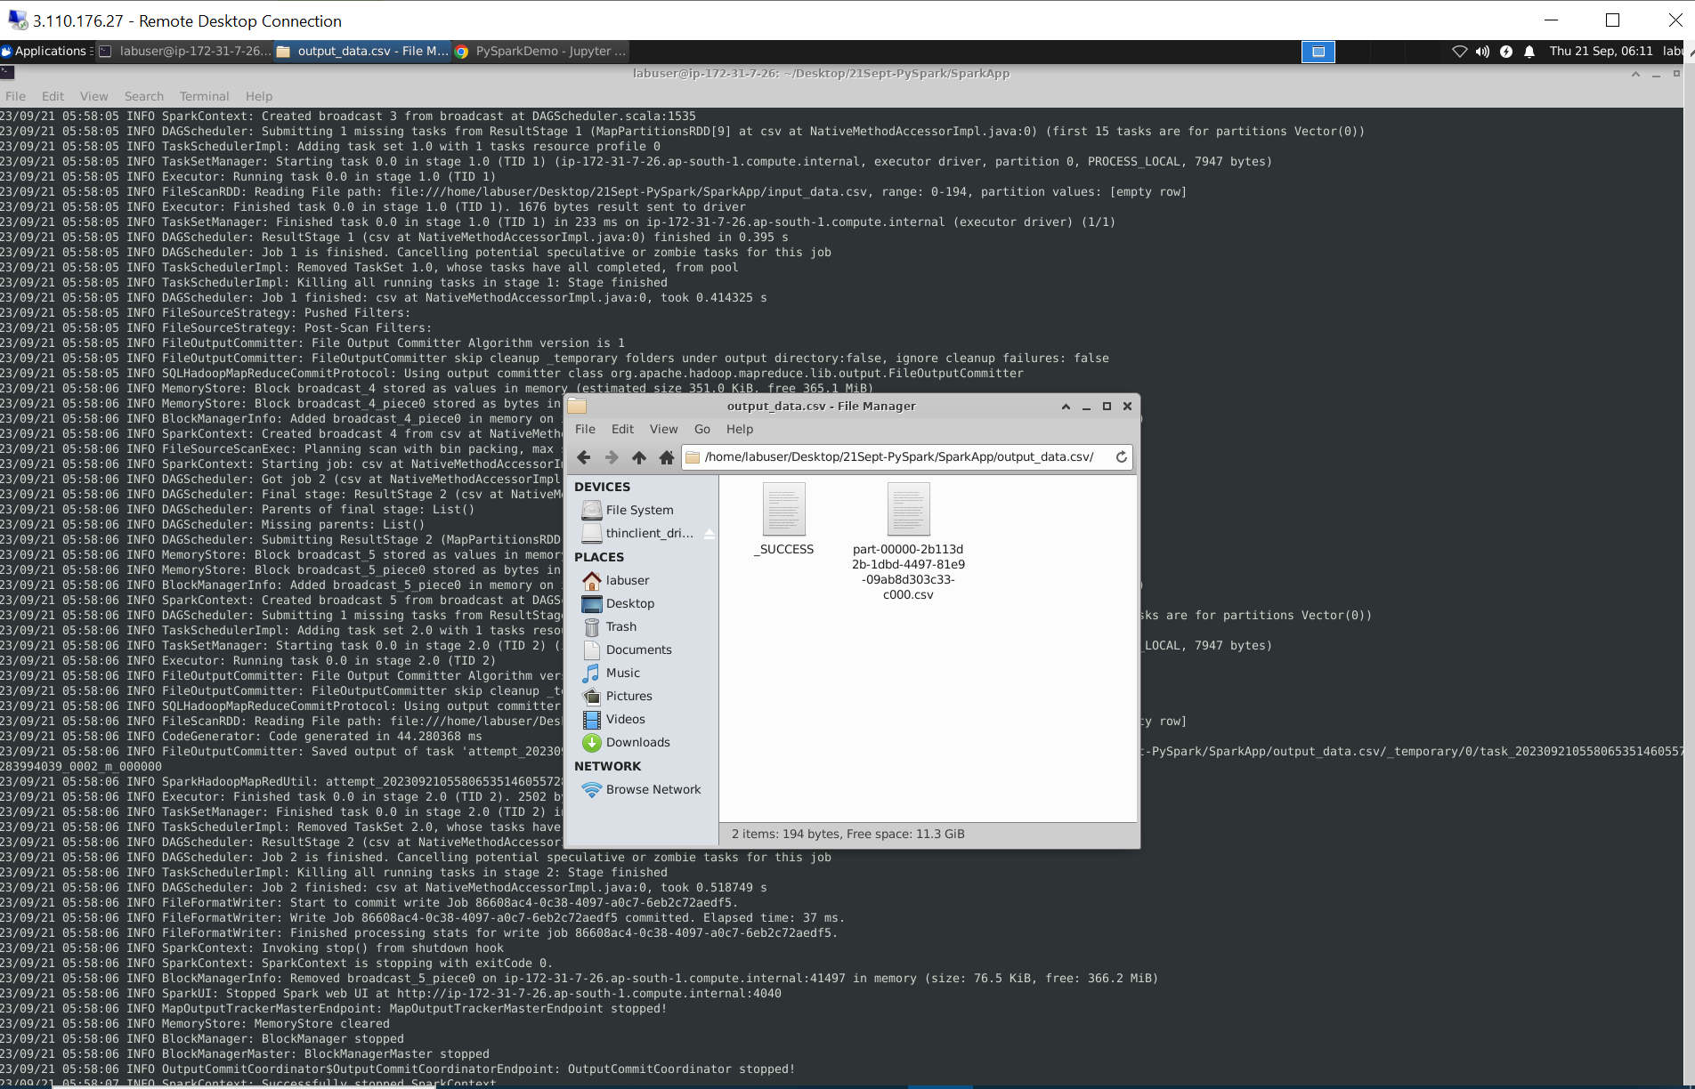

Slide 6
Day 4: PySpark
Data Handling in PySpark
Spark Caching and Fault Tolerance mechanisms are covered to optimize and ensure data reliability.
Transition from RDD to Dataframe is discussed, highlighting the flexibility of working with structured data.
PySpark SQL and CRUD operations on Dataframes are introduced, showcasing data manipulation capabilities.
File Handling and Formats
Common file handling operations like reading, writing, filtering, and appending data are explained.
The versatility of PySpark in handling various file formats, including CSV, Parquet, JSON, and more, is emphasized.

Slide 7
Day 5: PySpark
Data Cleaning and Subsetting
Exploring techniques for cleaning and subsetting data within PySpark.
Handling Null Values: Strategies for dealing with missing data, including filtering and dropping null values.
Transforming Data: Demonstrating various data transformation methods with real examples.

